Slide 1
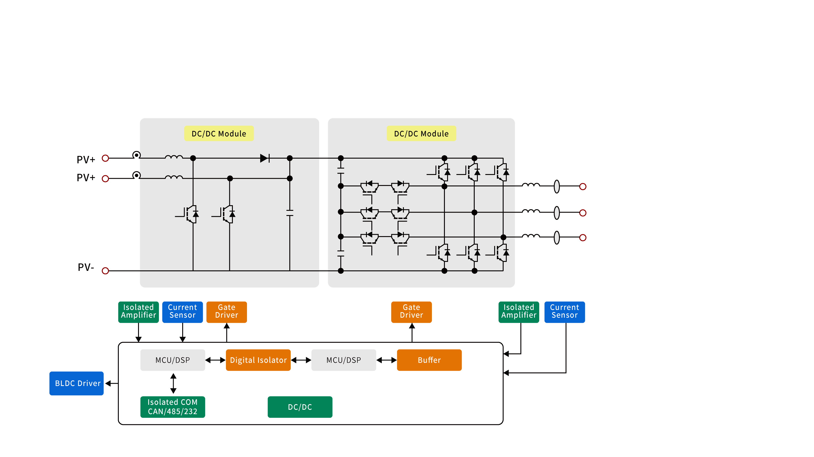
光伏逆变器拓扑
MP
Sample
In Design
Product Line | P/N
Current Sensor | CC69XX
Linear Hall | CC65XX
BLDC Driver | CC64XX/CCHXX
Product Line | P/N
Digital Isolator | CCi8741
Gate Driver | CCi833X/CC81XX
Digital Buffer | CC74ACT24x
Product Line | P/N
PMIC | CC35XX
Isolated Amp | CCi8610X
Isolated COM | CAN/485/...

Slide 2
户外储能－双向逆变器应用方案
MP
Sample
In Design
Product Line | P/N
Current Sensor | CC6924
Low VISO Current Sensor | CC6906
Product Line | P/N
Isolated Gate Driver | iCC833x
Non-Isolated Gate Driver | CC81xx
Digital Isolator | CCi874x
Product Line | P/N
Digital Isolator | CCi872x

Slide 3
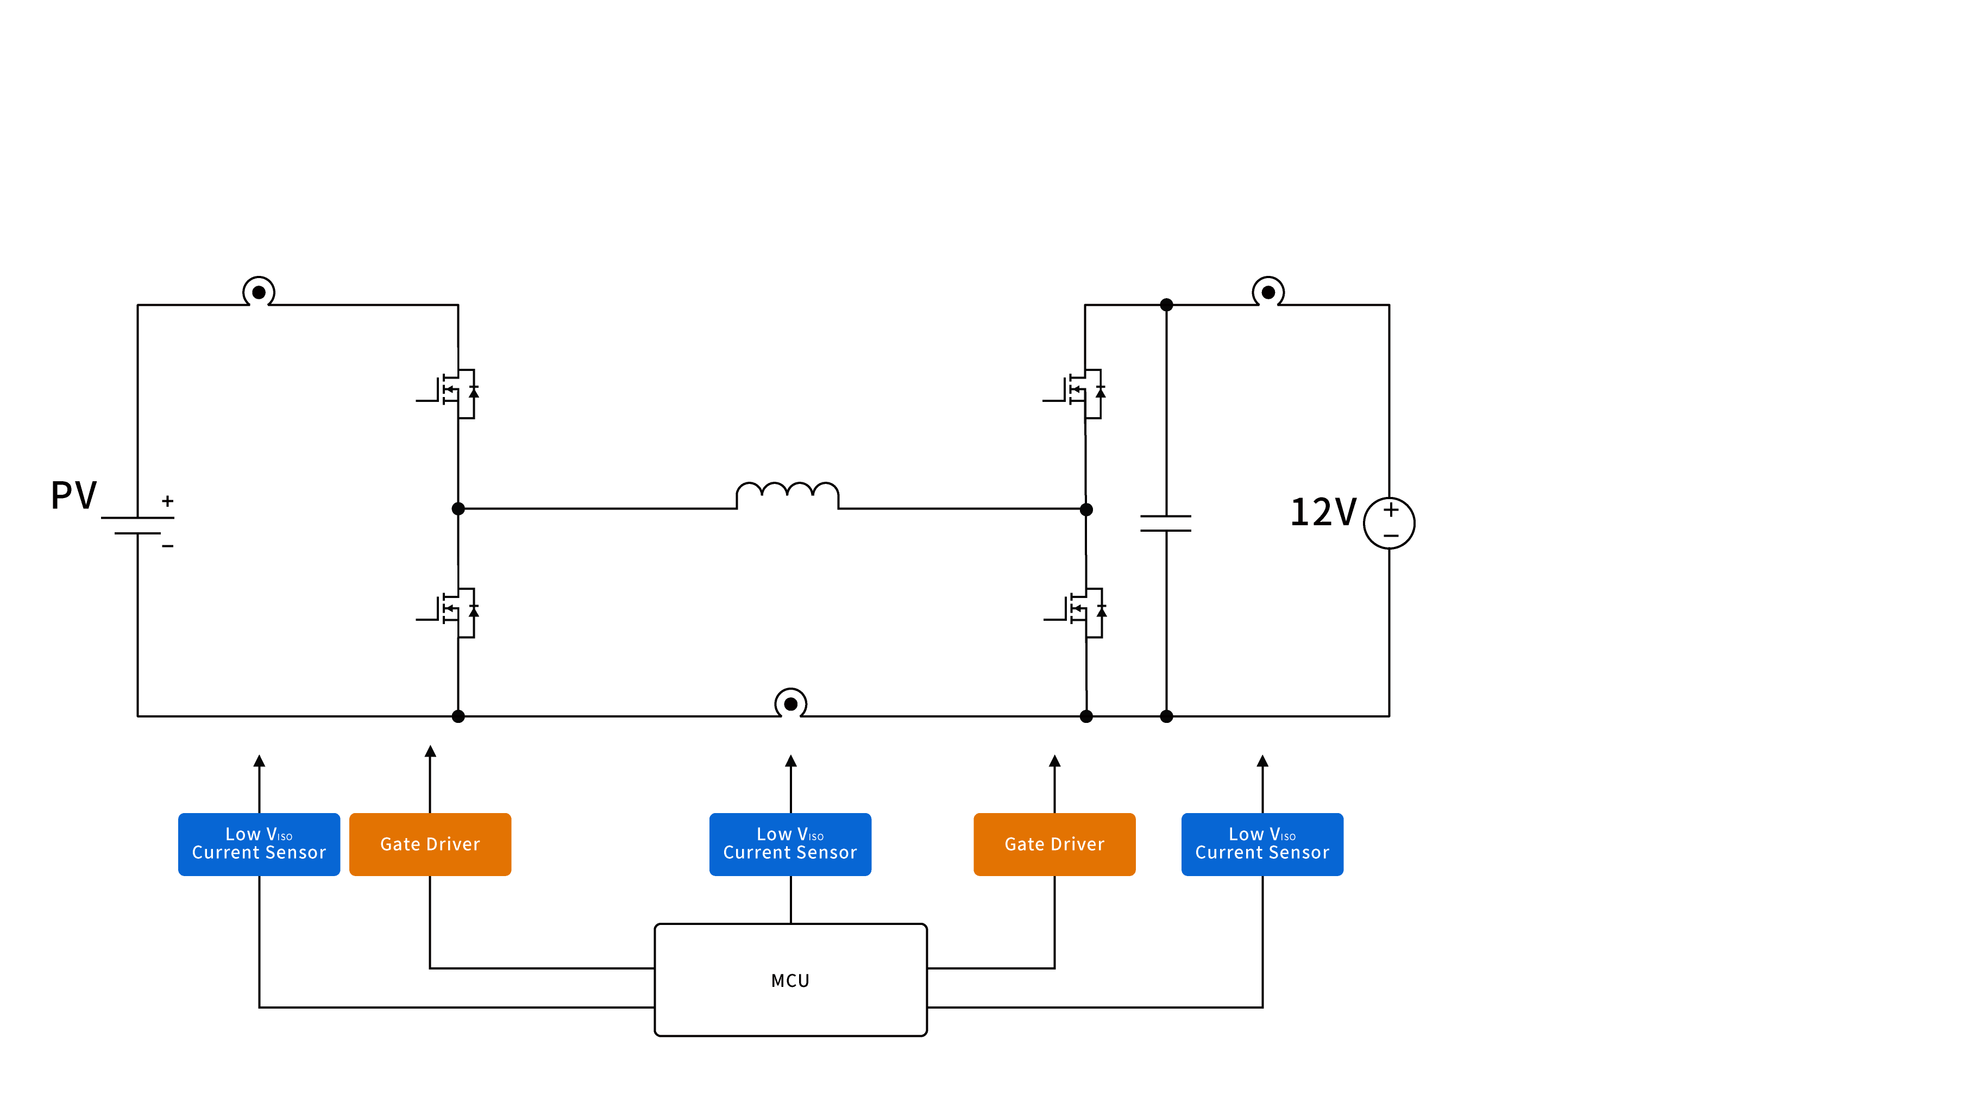
户外储能－12V车充双向应用方案
MP
Sample
In Design
Product Line | P/N
Low VISO Current Sensor | CC6905
Non-Isolated Gate Driver | CC81xx

Slide 4
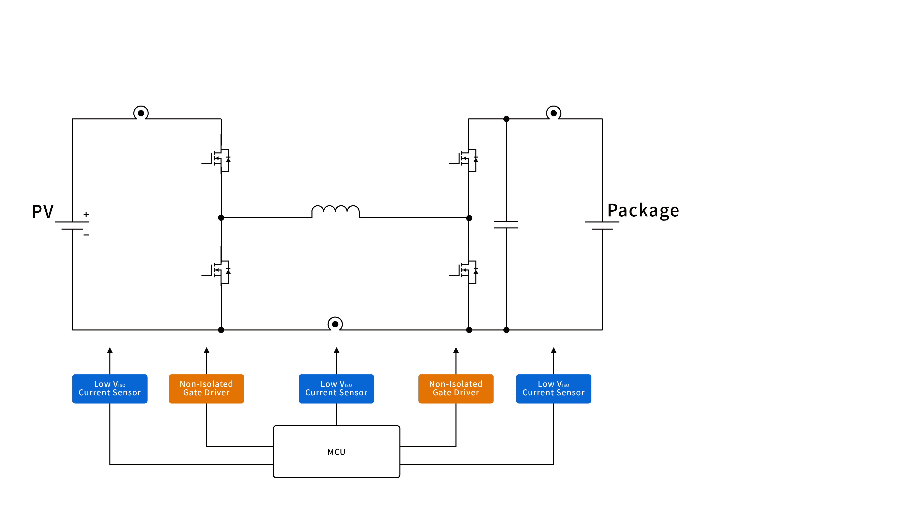
户外储能－光伏充电应用方案
MP
Sample
In Design
Product Line | P/N
Low VISO Current Sensor | CC6905
Non-Isolated Gate Driver | CC81xx

Slide 5
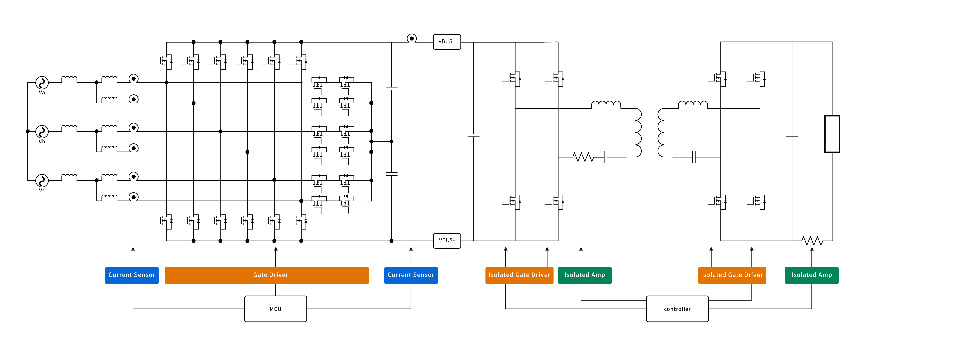
三相交错维也纳、双向CLLC
MP
Product Line | P/N
Current Sensor | CC6924
Low VISO Current Sensor | CC6906
Product Line | P/N
Isolated Gate Driver | iCC833x
Digital Isolator | CCi874x
Product Line | P/N
Isolated Amp | CCi8610X
Sample
In Design

